Slide 1

INDOOR SCENE RECOGNITION
VISHNU PRIYA JYESTA
Master of Professional Studies in Data Science
SPRING 2021
Instructor: Dr. Ergun Simsek

Slide 2
Description
Indoor scene recognition is a challenging open problem in high level vision. Most scene recognition models that work well for outdoor scenes perform poorly in the indoor domain. The main difficulty is that while some indoor scenes (e.g., corridors) can be well characterized by global spatial properties, others (e.g., bookstores) are better characterized by the objects they contain. More generally, to address the indoor scenes recognition problem we need a model that can utilize local and global discriminative information.

Slide 3
Aim
An indoor scene classification method which utilizes CNN feature of scene images to generate scene category features to classify scenes by a novel feature matching ML algorithm and Neural Networks.

Slide 4
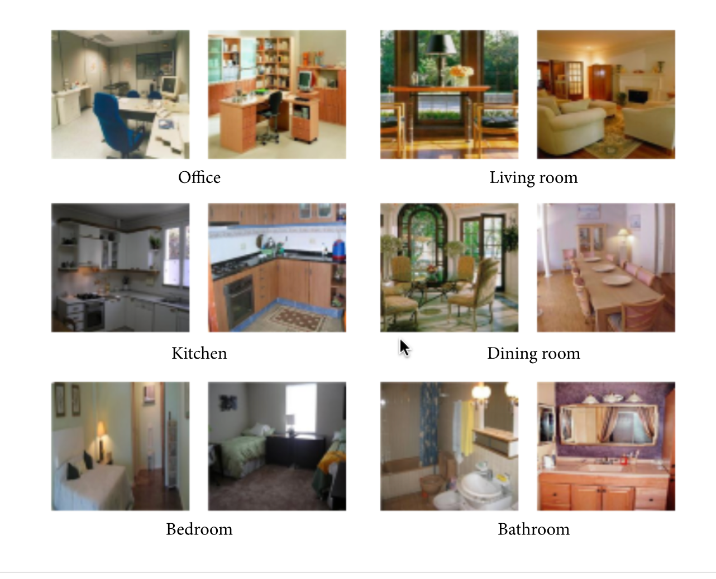
Dataset Information
The Dataset has 67 categories like bedroom, kitchen, garage, game room, airport, salon etc. and each category has at least 100 images and 15,687 RGB images totally.
The size of the Dataset is 2GB.
All these images are in jpg format.
All of 67 categories of indoor scene image are used to train the models.
Source : http://web.mit.edu/torralba/www/indoor.html

Slide 5
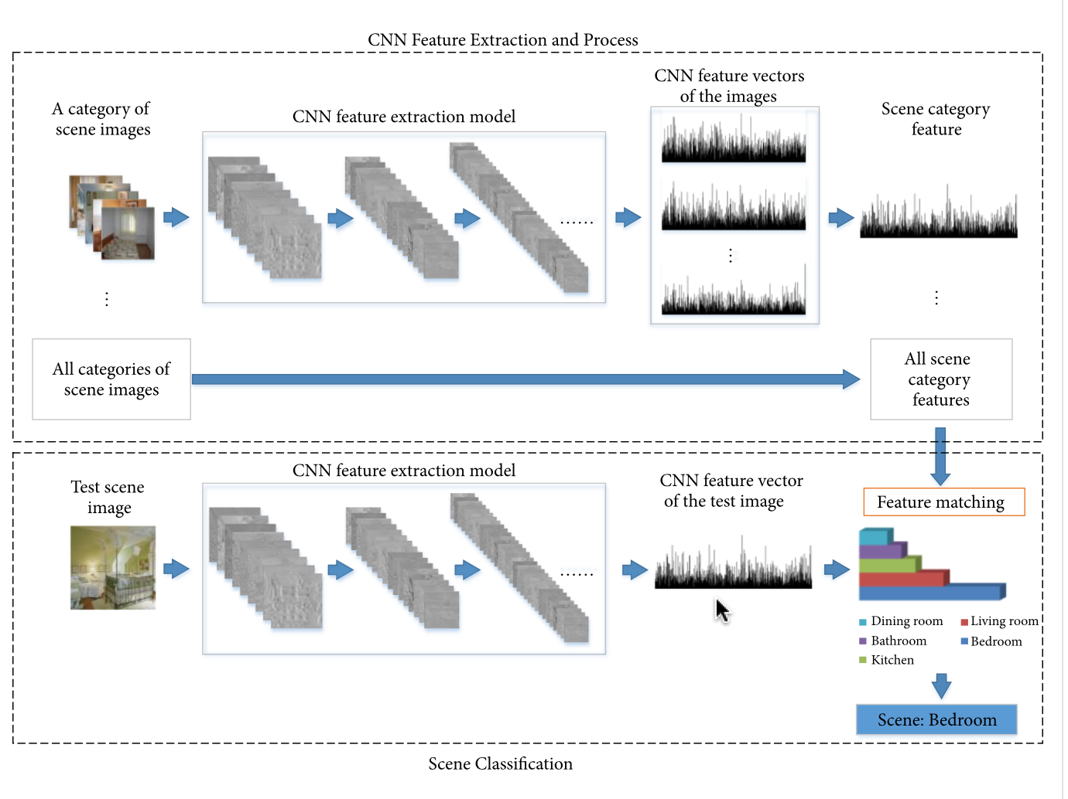
Planned Framework
Overall framework of the indoor scene classification method will be based on CNN feature. There are two parts in the framework. The first part is to generate scene category features by CNN feature extraction and process. The second step is to match CNN feature vector of the test scene image with the scene category features by a new feature matching algorithm to generate scores of different scenes. The largest score indicates the result of scene classification

Slide 6
ResNet
A residual network (ResNet), is an artificial neural network that helps to build deeper neural network by utilizing skip connections or shortcuts to jump over some layers. It's skipping helps build deeper network layers without falling into the problem of vanishing gradients.
There are different versions of ResNet, including ResNet-18, ResNet-34, ResNet-50, and so on. The numbers denote layers, although the architecture is the same. I have used the 18-layer ResNet18 in this project.

Slide 7
ResNet
There are two main types of blocks used:
Identity Block
Convolution Block
Transfer Learning with Pytorch:
The main aim of transfer learning (TL) is to implement a model quickly. To solve the current problem, instead of creating a DNN (dense neural network) from scratch, the model will transfer the features it has learned from the different dataset that has performed the same task. This transaction is also known as knowledge transfer.

Slide 8
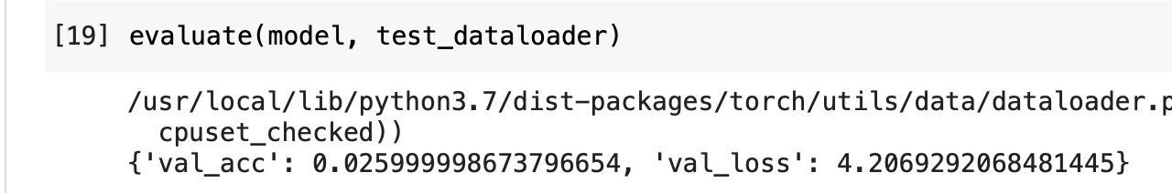
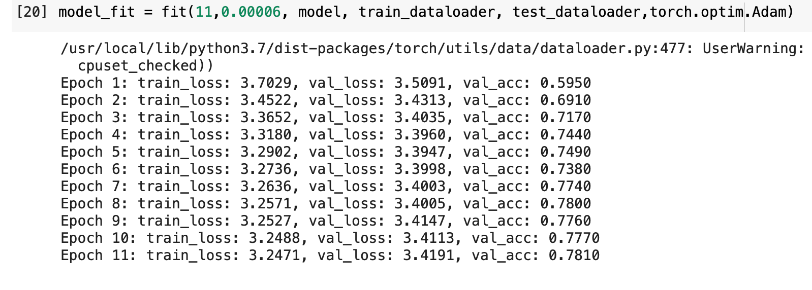
Implementation
Added a fully-connected layer for classification, specifying the classes and number of features and also tuned the parameters.
The initial accuracy is pretty low, so need to train the model. Let's train for 11 epochs and evaluate the performance for learning of 0.00006.

Slide 9
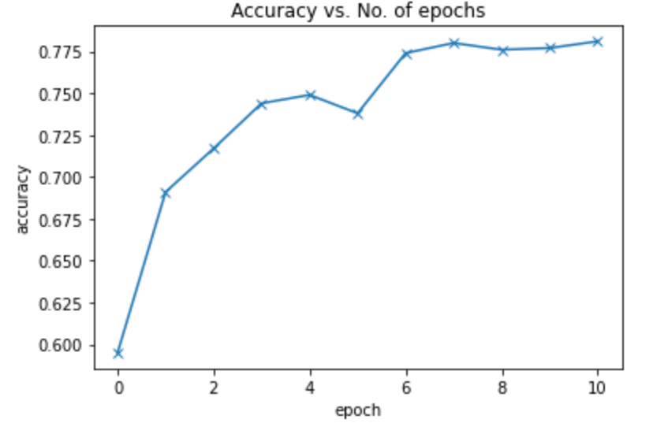
Accuracy Vs Epoch
The model has accuracy of 78% and it predicts the external scenes correctly.

Slide 10
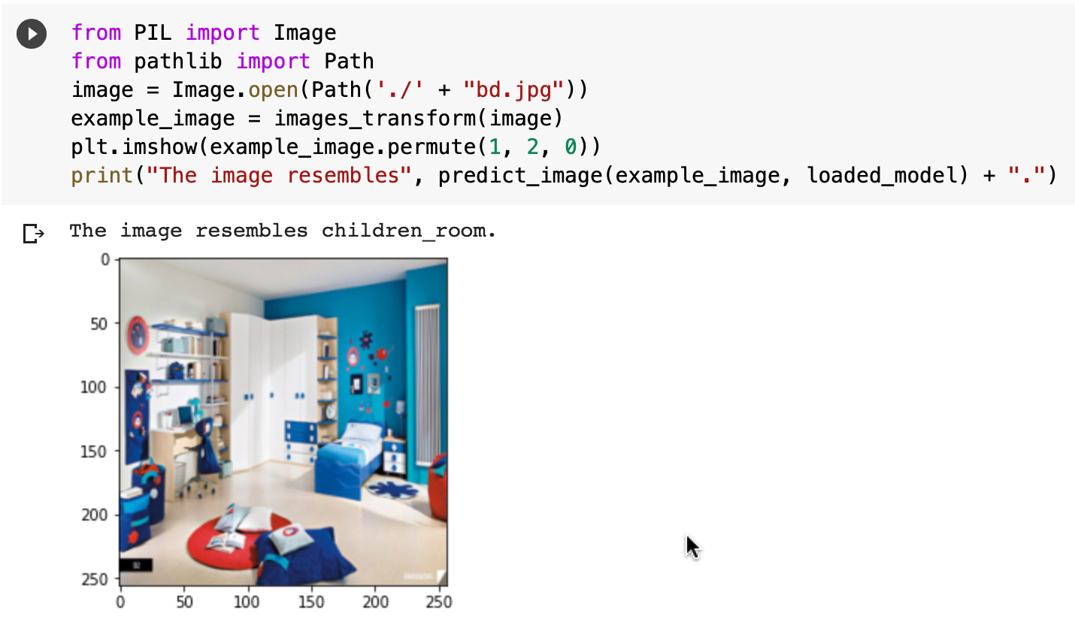
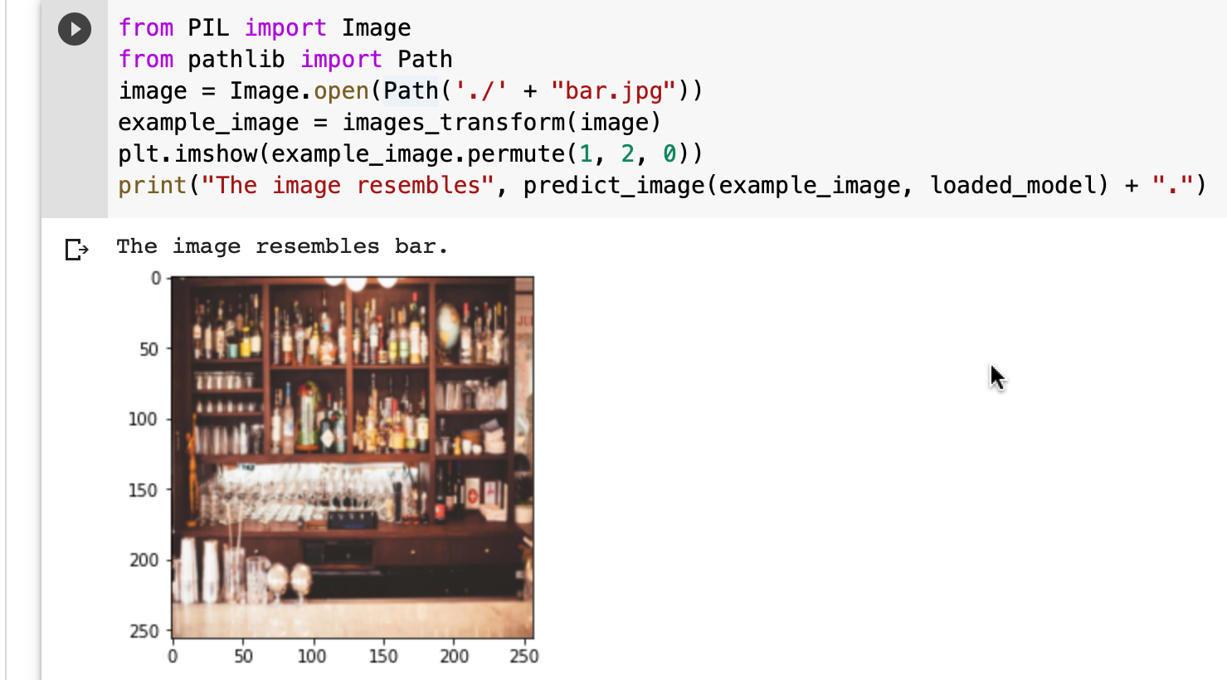
Evaluation with External Images
Adding PIL library for loading external image from drive and the predictions were made correctly.
The external images like children room and bar were predicted correctly.

Slide 11
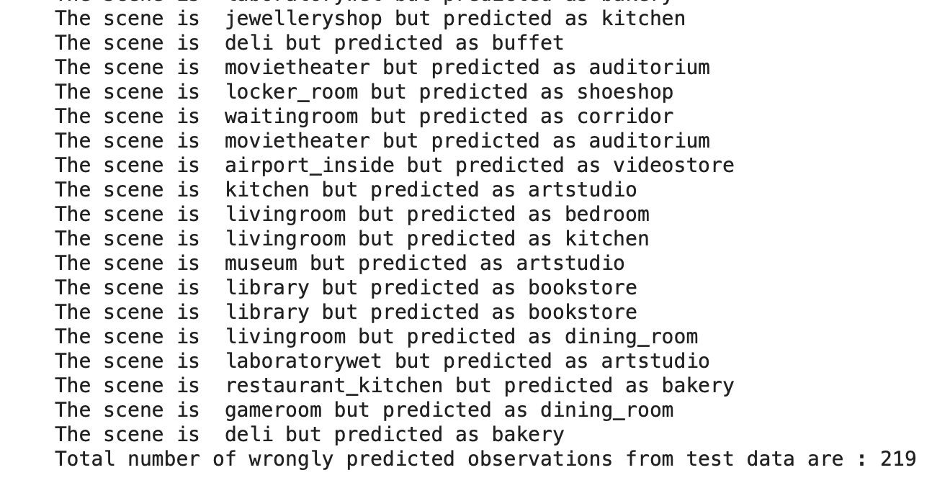
Evaluation with Test Dataset Images
I looped over all the test dataset images and there were around 200 images which were predicted incorrectly.

Slide 12
References
A. Quattoni and A. Torralba, “Recognizing indoor scenes,” in Proceedings of the IEEE Computer Society Conference on Computer Vision and Pattern Recognition Workshops (CVPR Workshops '09), pp. 413–420, Miami, USA, June 2009.
Shaopeng Liu, Guohui Tian, "An Indoor Scene Classification Method for Service Robot Based on CNN Feature", Journal of Robotics, vol. 2019, Article ID 8591035, 12 pages,2019. https://doi.org/10.1155/2019/8591035
Singhal, G. (2020, May 05). Gaurav Singhal. Retrieved April 05, 2021, from https://www.pluralsight.com/guides/introduction-to-resnet
Fotache, C. (2018, December 10). How to train an image classifier In pytorch and use it to perform Basic inference on single images. Retrieved April 05, 2021, from https://towardsdatascience.com/how-to-train-an-image-classifier-in-pytorch-and-use-it-to-perform-basic-inference-on-single-images-99465a1e9bf5
López-Cifuentes, A., Escudero-Viñolo, M., Bescós, J., & García-Martín, Á. (2020). Semantic-aware scene recognition. Pattern Recognition, 102, 107256. doi:10.1016/j.patcog.2020.107256
Du, D., Wang, L., Wang, H., Zhao, K., & Wu, G. (2019). Translate-to-Recognize networks FOR RGB-D Scene Recognition. 2019 IEEE/CVF Conference on Computer Vision and Pattern Recognition (CVPR). doi:10.1109/cvpr.2019.01211
Dalvi, A. (2021, February 09). Tackling multi-class image classification problem with transfer learning using pytorch. Retrieved May 06, 2021, from https://medium.com/walmartglobaltech/tackling-multi-class-image-classification-problem-with-transfer-learning-using-pytorch-50150b215fb6

Slide 13
THANK YOU
ANY QUESTIONS & FEEDBACK
vjyesta1@umbc.edu

